Slide 1
Source: template risk assessment
How do we document our COVID-19 Risk Assessment
What is the risk or hazard identified? | Who might be harmed and how? | What is the potential impact? (High / Medium / Low) | What is the likelihood of the risk occurring? (High / Medium / Low) | What is the overall risk level? (High / Medium / Low) | What is the firm already doing to control the risks? | What steps should be put in place to avoid or mitigate the risks? | By whom? | By when?
Spread of COVID-19 to Staff from working at their workstations | Staff likely to be affected? | High / Medium / Low | High / Medium / Low | High / Medium / Low |  | This may necessitate a number of different measures
Spread of COVID-19 to staff from use of toilets | Who will likely be affected? | High / Medium / Low | High / Medium / Low | High / Medium / Low
Spread of COVID-19 to staff from use of kitchen space | Who will likely be affected? | High / Medium / Low | High / Medium / Low | High / Medium / Low
Spread of COVID-19 to staff from gaining access to workstation (communal areas / reception etc) | Who will likely be affected? | High / Medium / Low | High / Medium / Low | High / Medium / Low
Notes:
This is an example that DG Legal have produced. Please don’t blindly copy this example – of course many of these will apply to you but think about your own circumstances and adapt it accordingly.

Slide 2
How do we document our COVID-19 Risk Assessment
What is the risk or hazard identified? | Who might be harmed and how? | What is the potential impact? (High / Medium / Low) | What is the likelihood of the risk occurring? (High / Medium / Low) | What is the overall risk level? (High / Medium / Low) | What is the firm already doing to control the risks? | What steps should be put in place to avoid or mitigate the risks? | By whom? | By when?
Spread of COVID-19 to Visitors to your premises | Who will likely be affected? | High / Medium / Low | High / Medium / Low | High / Medium / Low
Spread of COVID-19 to Cleaners | Who will likely be affected? | High / Medium / Low | High / Medium / Low | High / Medium / Low
Spread of COVID-19 to contractors |  | High / Medium / Low | High / Medium / Low | High / Medium / Low
Spread of COVID-19 to Vulnerable groups – Elderly, Pregnant workers, and those with existing underlying health conditions |  | High / Medium / Low | High / Medium / Low | High / Medium / Low

Slide 3
How do we document our COVID-19 Risk Assessment
COVID-19 Health & Safety Action List (in order of priority):
[As a result of its risk assessment, a firm may consider that it needs to prioritise some more urgent actions and these could be documented here]
The following priority actions are planned commencing [DATE]:
Action | By whom | Start date | Review Date

Slide 4
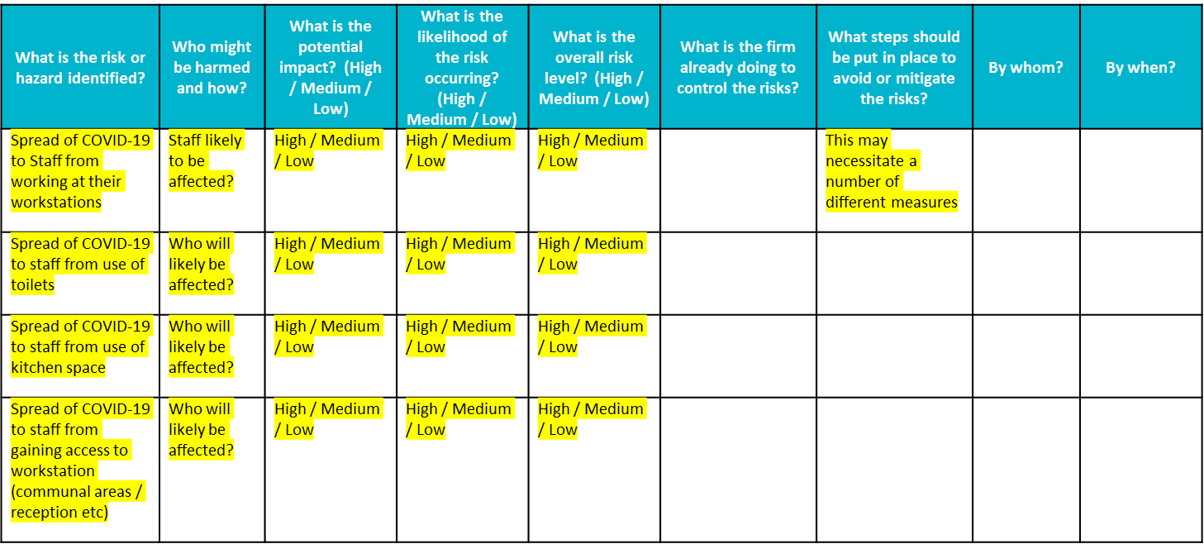
What practical measures must we implement when we re-open the office?
This will be determined by your risk assessment
You will need to access the office & determine what measures can be implemented
Factor in the time it will take to implement, for example:
Who will reconfigure the desks and when?
Do you need to purchase PPE and floor tape?
Notes:
The measures you will need to implement will be determined entirely by your COVID-19 risk assessment.
You will need to access the premises and work as a team to determine what measures can practically be implemented.
Factor in the time it will take you to put these measures into place. For instance, if you determine that you need to reconfigure your desks, work out who will do this and when. You may have identified that you need to purchase certain equipment – such as personal protective equipment or floor tape to delineate safe areas – which may not be readily available at present. You will need to ensure that the equipment is in place and all necessary measures implemented before you change the working arrangements. Even if you are not planning to open the office soon, all firms should consider now what they may need to have in place when they re-open.

